Slide 1
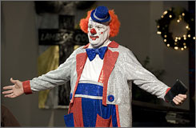
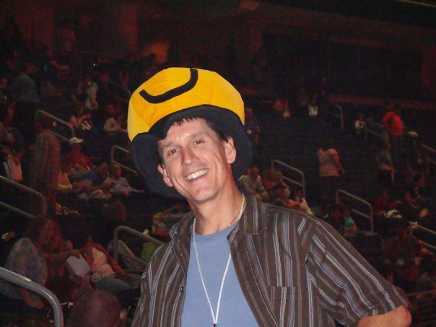
Reverend Tom Rives
photo by Steve Nesius, AP taken from usatoday.com
John 20.1-18
Pastor Chris Cahill
taken from his Facebook page

Slide 2
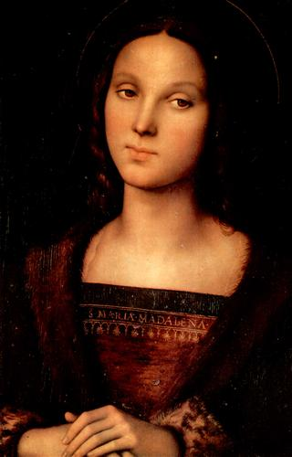
John 20.1-2 ESV: Now on the first day of the week Mary Magdalene came to the tomb early, while it was still dark, and saw that the stone had been taken away from the tomb. So she ran and went to Simon Peter and the other disciple, the one whom Jesus loved, and said to them, “They have taken the Lord out of the tomb, and we do not know where they have laid him.”
Pietro Perugino; Galleria Palatina, Florence, Italy; taken from wikiart.org

Slide 3
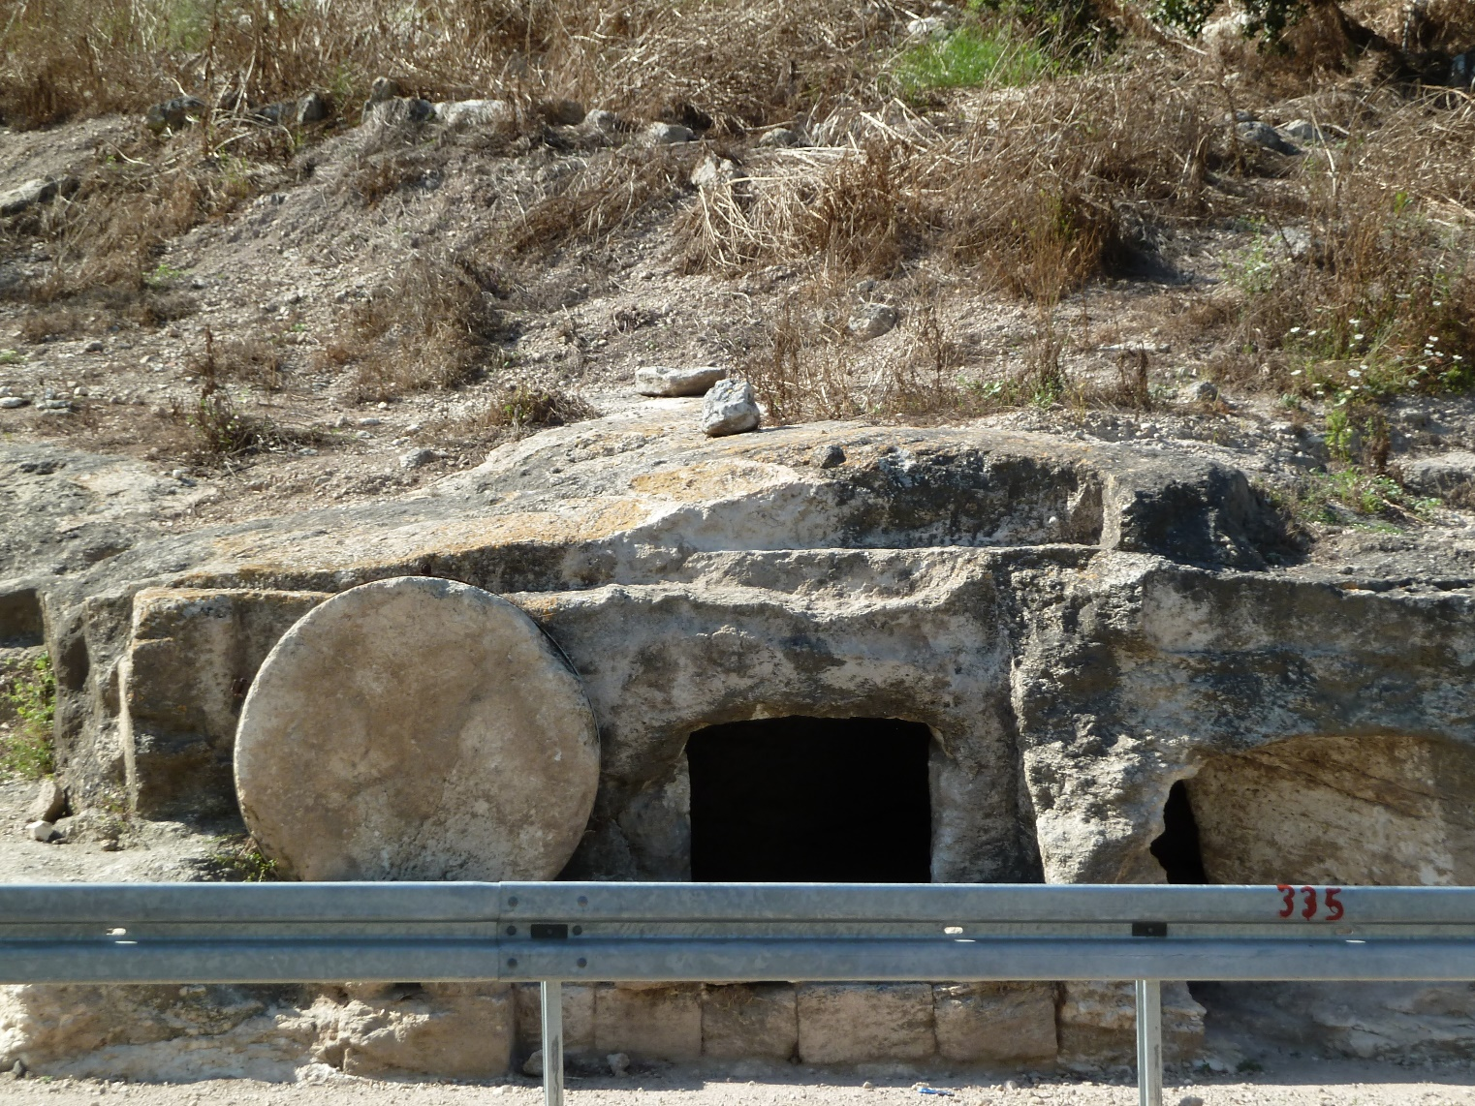
John 20.3-5: So Peter went out with the other disciple, and they were going toward the tomb. Both of them were running together, but the other disciple outran Peter and reached the tomb first. And stooping to look
in, he saw the
linen cloths
lying there, but
he did not go in.
Actual tomb in Israel

Slide 4
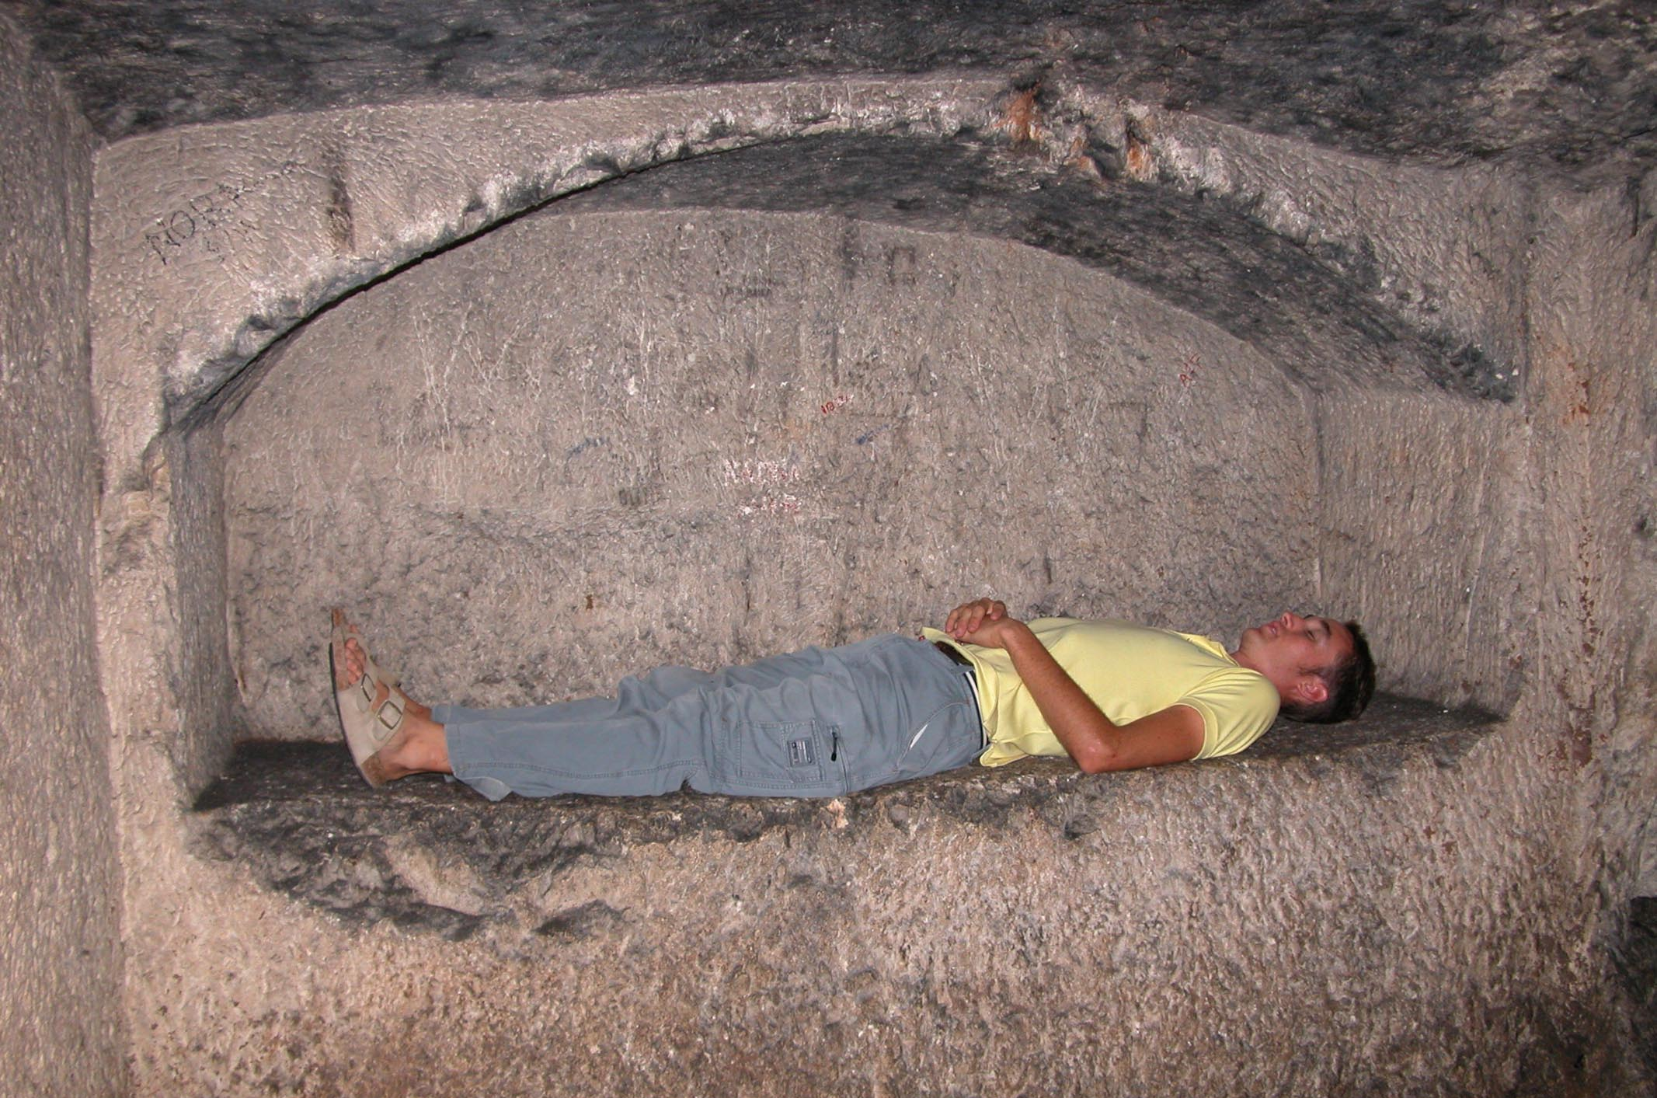
John 20.6-10: Then Simon Peter came, following him, and went into the tomb. He saw the linen cloths lying there, and the face cloth, which had been on Jesus’ head, not lying with the linen cloths but folded up in a place by itself. Then the other disciple, who had reached the tomb first, also went in, and he saw and
believed; for as yet
they did not
understand the
Scripture, that he
must rise from the
dead. Then the
disciples went back
to their homes.
© 2012 Todd Bolen / BiblePlaces.com

Slide 5
John 20.11-13: But Mary stood weeping outside the tomb, and as she wept she stooped to look into the tomb. And she saw two angels in white, sitting where the body of Jesus had lain, one at the head and one at the feet. They said to her, “Woman, why are you weeping?” She said to them, “They have taken away my Lord, and I do not know where they have laid him.”

Slide 6
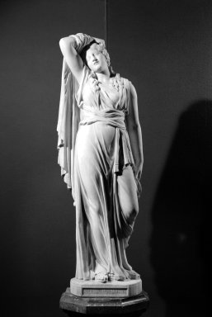
John 20.14-15: Having said this, she turned around and saw Jesus standing, but she did not know that it was Jesus. Jesus said to her, “Woman, why are you weeping? Whom are you seeking?” Supposing him to be the gardener, she said to him, “Sir, if you have carried him away, tell me where you have laid him, and I will take him away.”
Richard Saltonstall Greenough
BrooklynMuseum.org

Slide 7
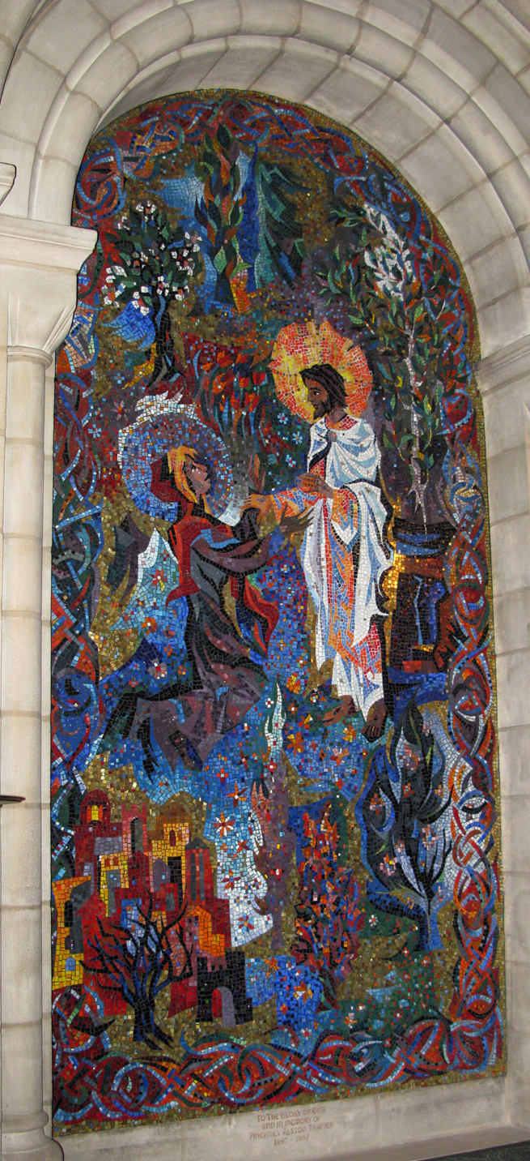
Rowan & Irene LeCompte / Washington Cathedral / Vanderbilt.edu
John 20.16-18: Jesus said to her, “Mary.” She turned and said to him in Aramaic, “Rabboni!” (which means Teacher). Jesus said to her, “Do not cling to me, for I have not yet ascended to the Father; but go to my brothers and say to them, ‘I am ascending to my Father and your Father, to my God and your God.’” Mary Magdalene went and announced to the disciples, “I have seen the Lord”-- and that he had said these things to her.

Slide 8
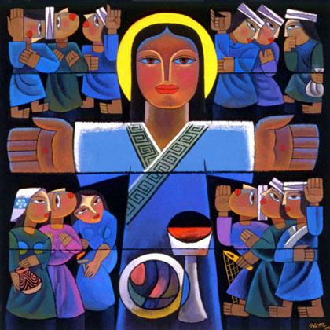
1 Corinthians 15.14 NET: And if Christ has not been raised, then our preaching is futile and your faith is empty.
“The Risen Lord”
by Qi He
taken from Vanderbilt.edu

Slide 9
